Slide 1
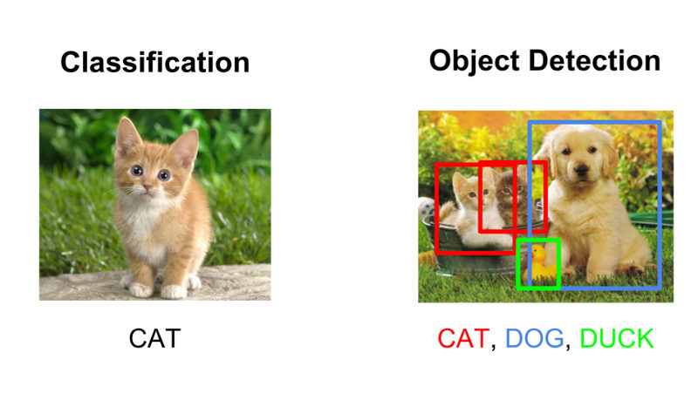

Intel Image Classification
Edison

Slide 2

Background
Originally a Intel competition held on https://datahack.analyticsvidhya.com
Multi-Class Classification problem
Buildings
Forest
Glacier
Mountain
Sea
Street

Slide 3
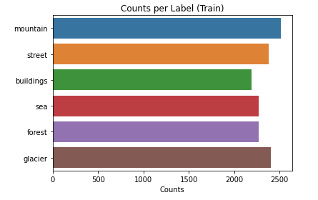
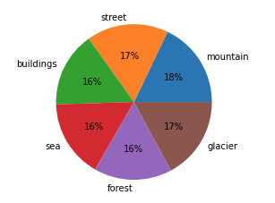
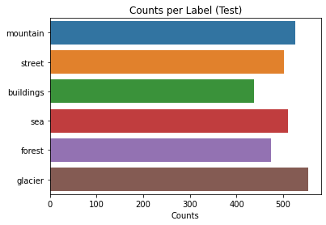
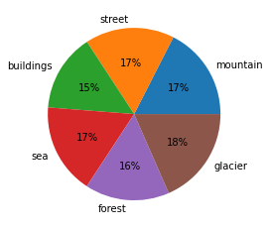
Dataset
14k training images
3k test images
~2200 per label
Balanced

Slide 4
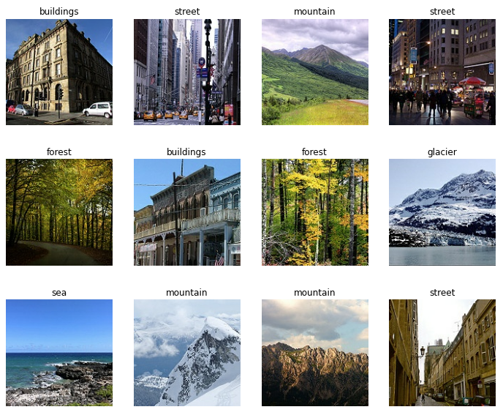

Sample Images

Slide 5
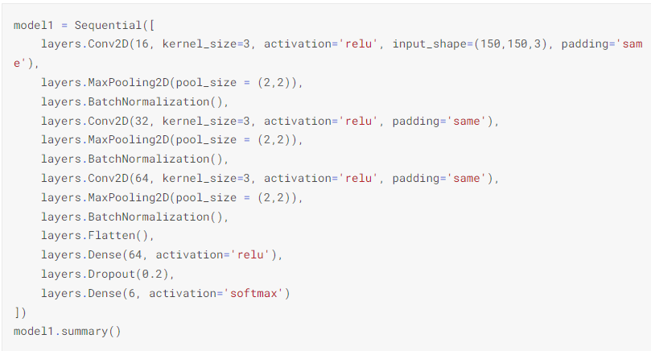
Model Architecture
Notes:
Conv2D in 3x3 tends to be just as effective as larger filters like 5x5
Relu tends to work well with just about everything so we are keeping it here
Padding is same so we don't shrink our image
MaxPooling in a 2x2 to help with overfitting and reducing variables
BatchNormalization to normalize data to make it more stable
Dropout to also avoid overfitting
Softmax output is necessary for multiclass classification

Slide 6
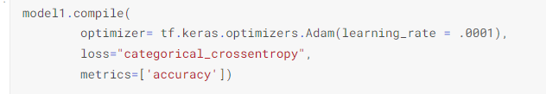
Optimizers and Loss Function
Notes:
We will use Adam for optimatization as it tends to work well with a lot of things and a standard learning rate of 0.0001 to start off.
The loss will be categorical crossentropy as that is the loss function used for multiclass classification and we will only be concerned with accuracy this time.

Slide 7
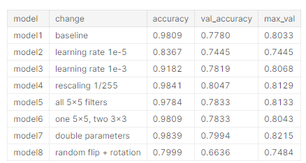
Results Summary

Slide 8
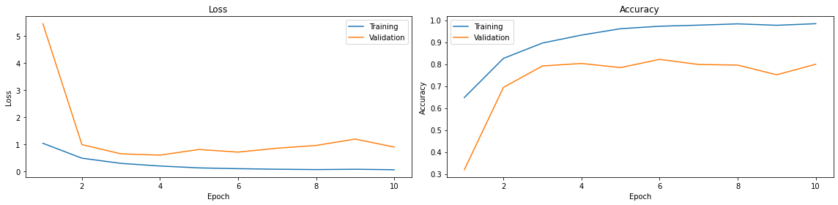
Double Filters Model

Slide 9
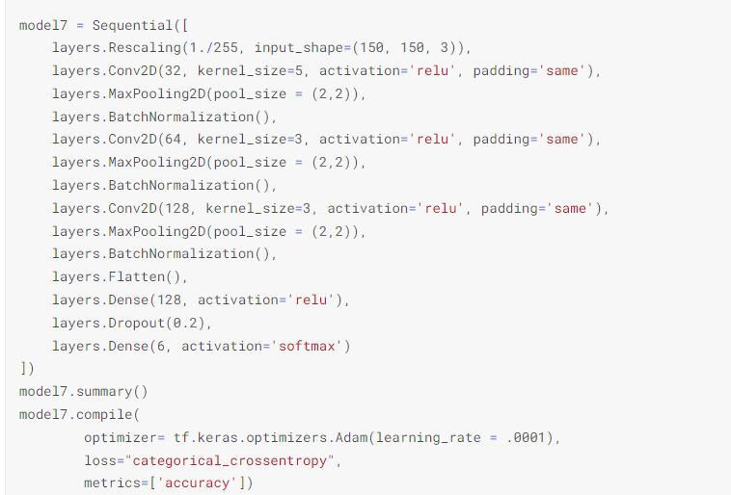
Double Filters Model

Slide 10
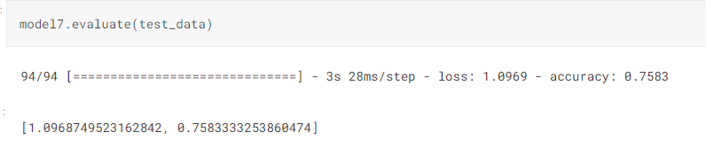
Conclusion

Slide 11
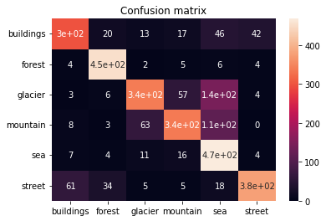
Confusion Matrix

